Slide 1
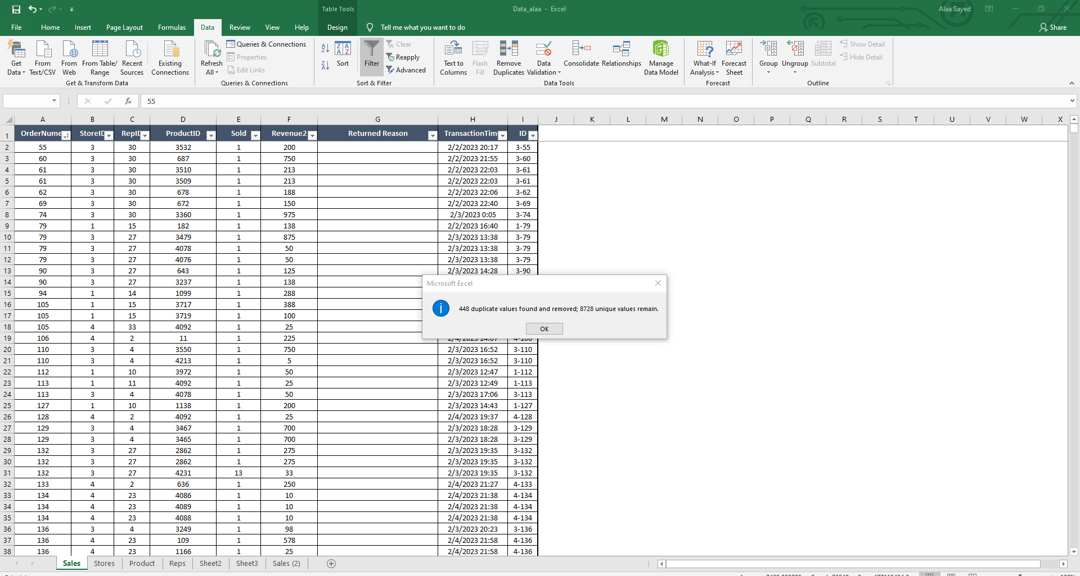
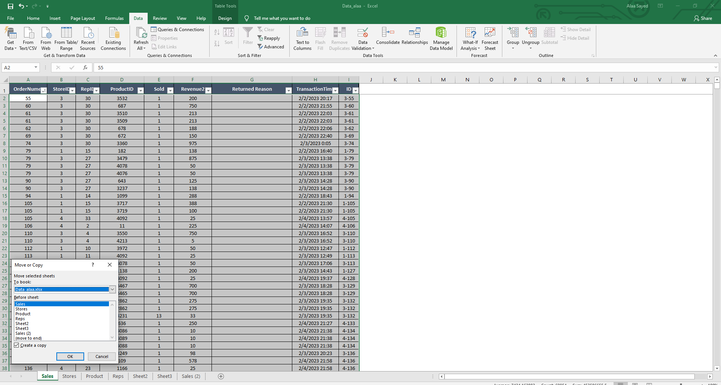
1.Execl
Add new Sheet with lookups for each ID with Related Info.
After Lookups, Calculations (use Formula or Pivot Table)
Get Top 20 Products per Sold.
Get Top 10 Reps per Count of Order number.
Get Top & Worst 10 Brand per Value.
Rank Month in Each Stores.
Rank Reps in each Stores.
Rank Products in each Brand.

Slide 2
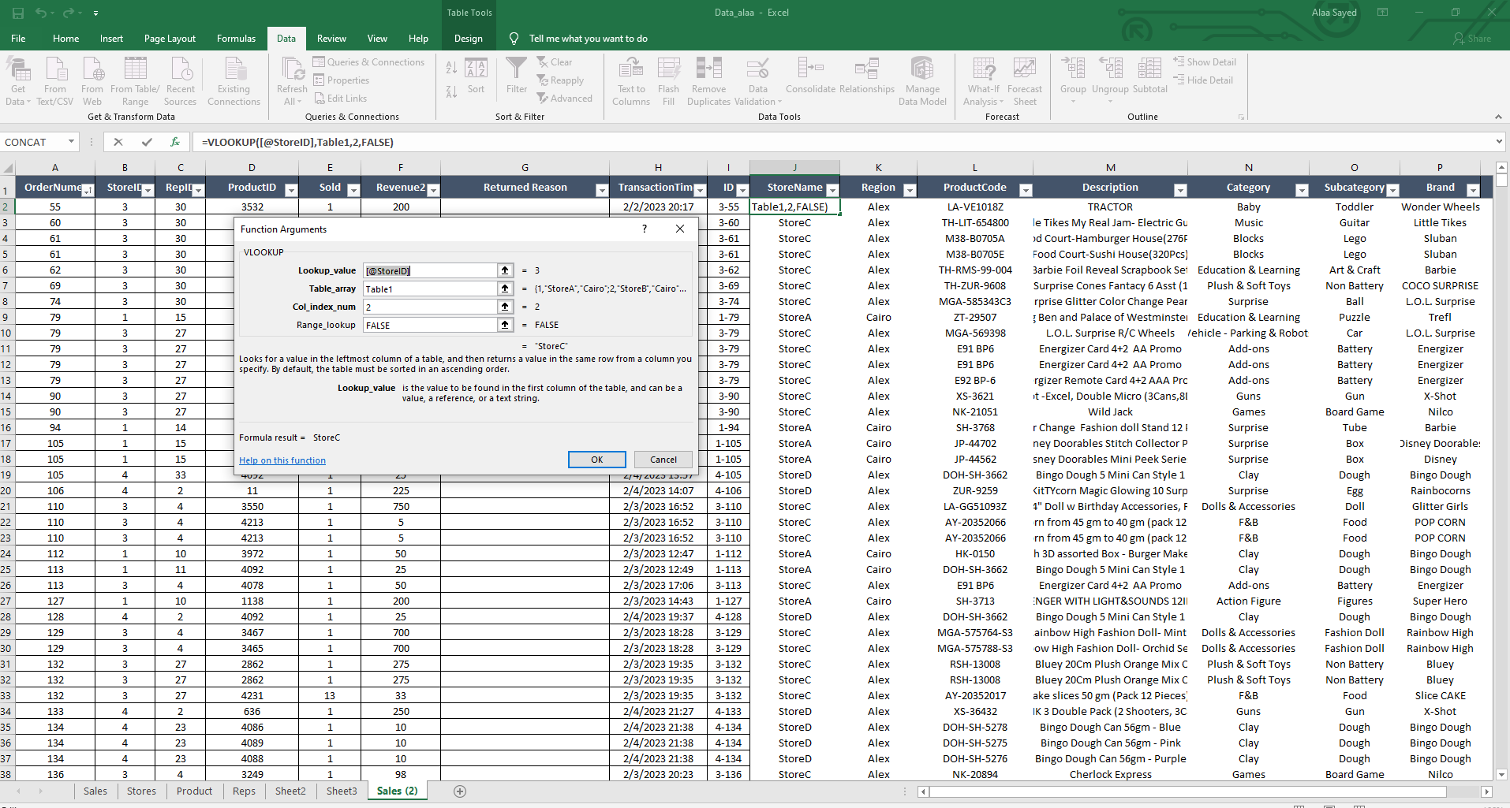
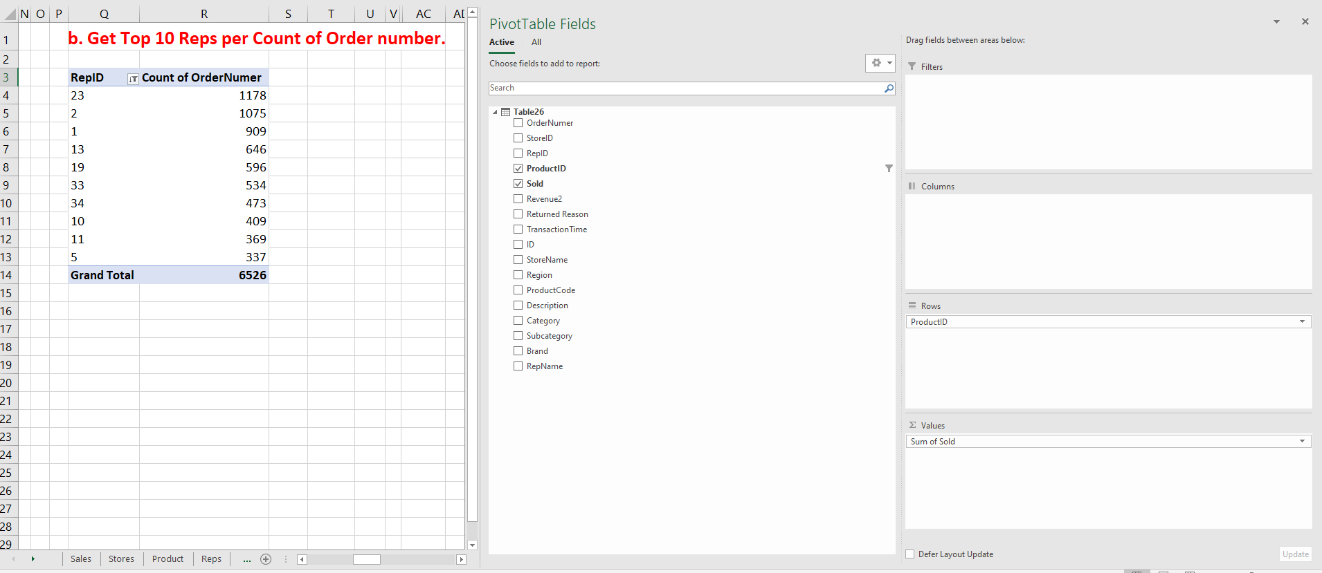
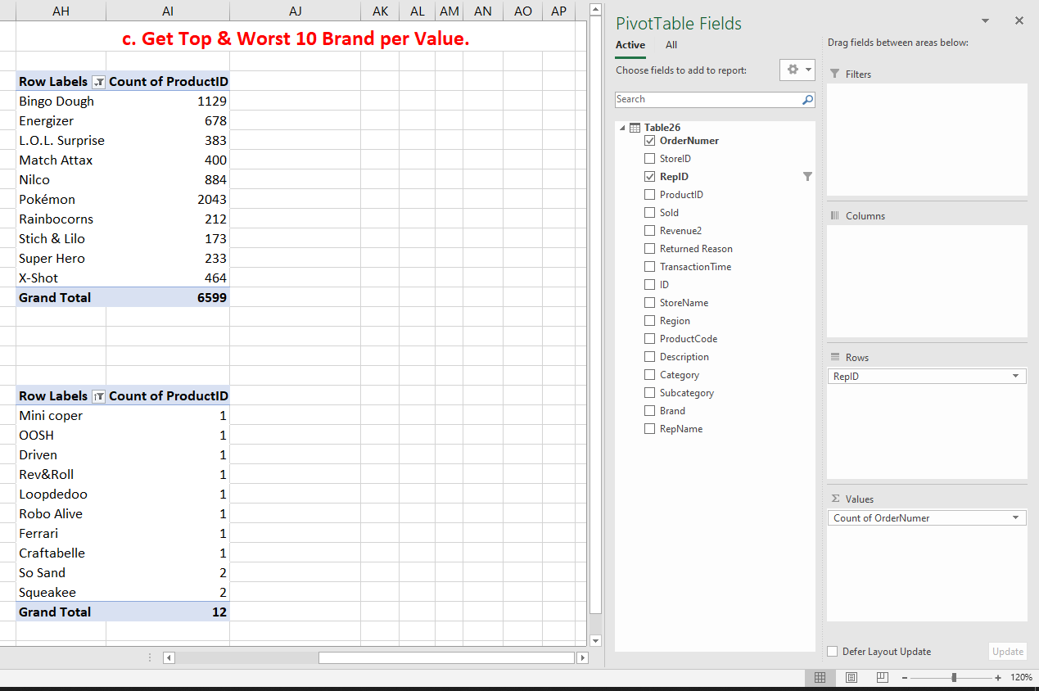
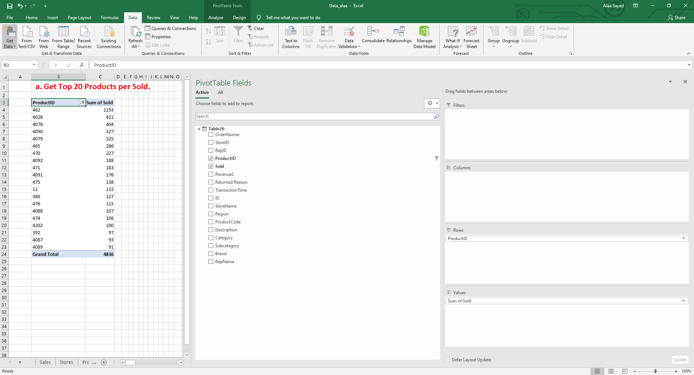

Slide 3
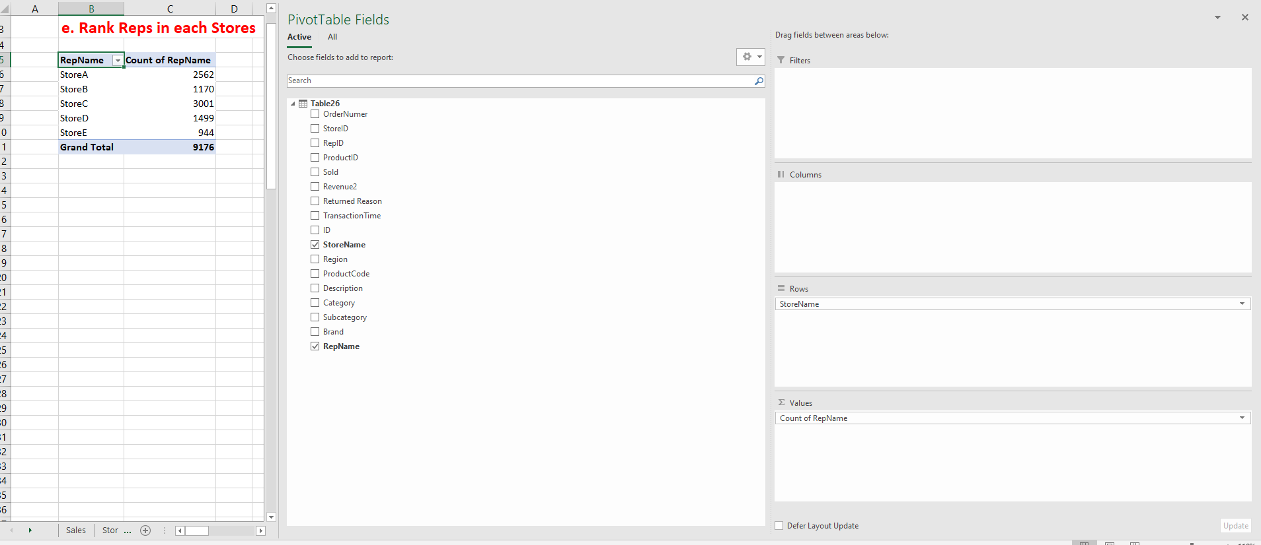
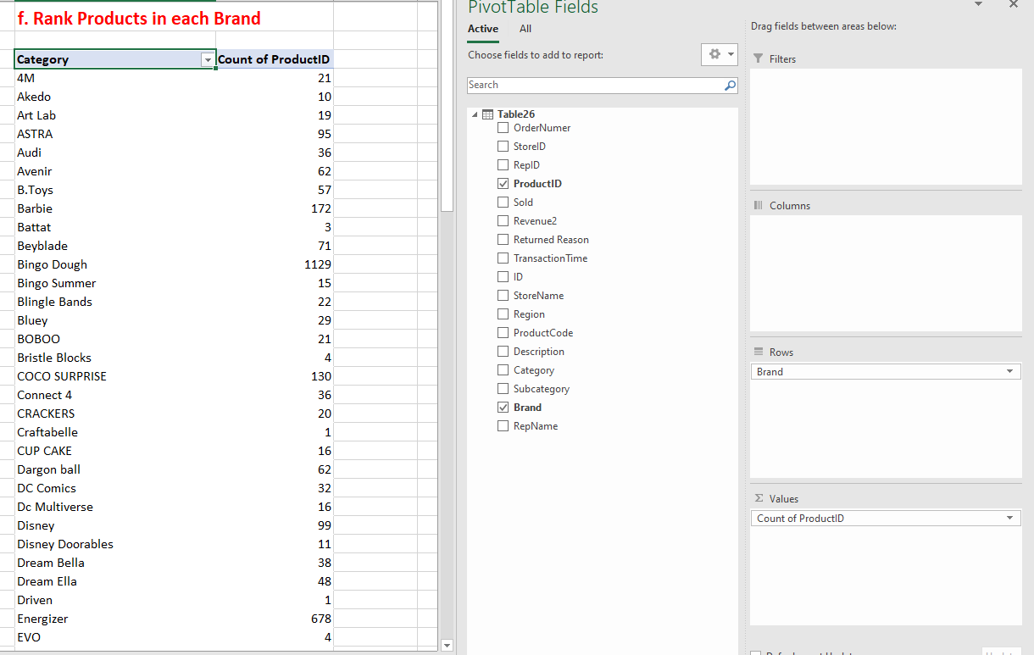
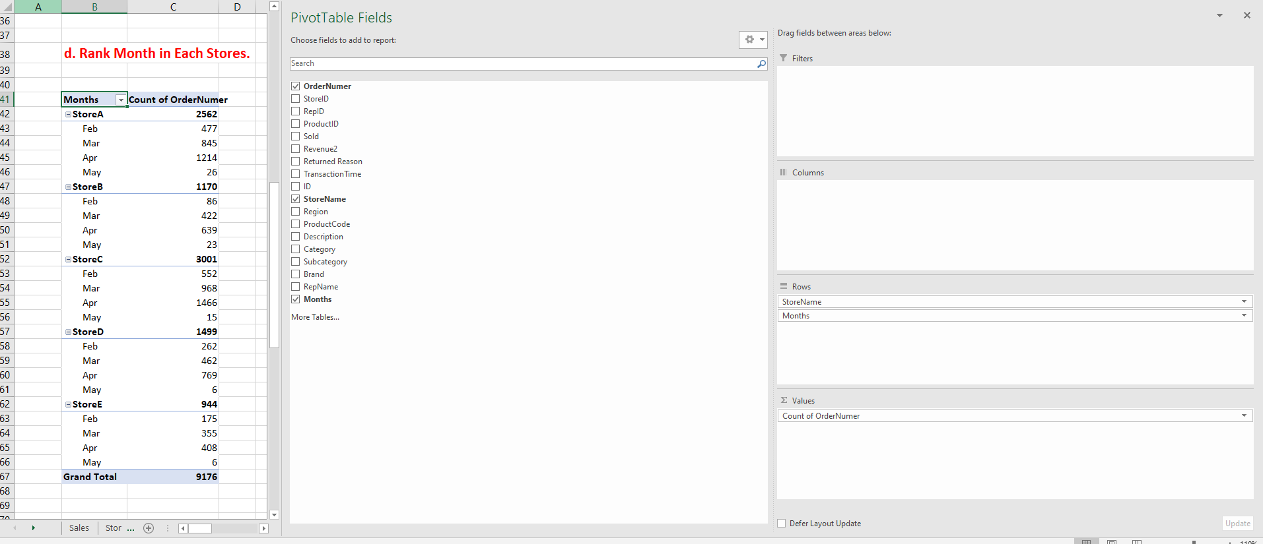
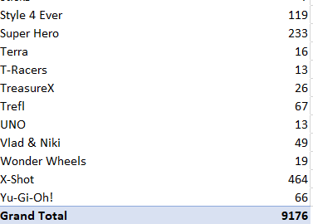

Slide 4
2. Use SQL Server and SSIS to Solve the Challenges:
Create a star schema of the data using Microsoft SQL Server.
create an ETL pipelines using SSIS to populate the cleaned data into the DWH.
You should define the facts and dimensions and decide what columns belongs to the facts/dimension’s tables according to your understanding of the data.

Slide 5
-- Create Rep Dimension Table
CREATE TABLE Dim_Rep (
RepID INT PRIMARY KEY,
RepName NVARCHAR(255)
);
-- Create Time Dimension Table
--CREATE TABLE Dim_Time (
-- TransactionTime DATETIME PRIMARY KEY
-- Add more time-related attributes as needed (e.g., day, month, year)
--);
-- Create Sales Fact Table
CREATE TABLE Sales (
OrderNumber INT,-- PRIMARY KEY,
StoreID INT,
ID INT,
RepID INT,
ProductID INT,
Sold INT,
Revenue DECIMAL(10, 2),
ReturnedReason NVARCHAR(255),
TransactionTime DATETIME,
FOREIGN KEY (StoreID) REFERENCES Dim_Store(StoreID),
FOREIGN KEY (RepID) REFERENCES Dim_Rep(RepID),
FOREIGN KEY (ProductID) REFERENCES Dim_Product(ProductID),
--FOREIGN KEY (ReturnedReasonID) REFERENCES Dim_ReturnedReason(ReasonID)
);
-- Create Store Dimension Table
CREATE TABLE Dim_Store (
StoreID INT PRIMARY KEY,
StoreName NVARCHAR(255),
Region NVARCHAR(255)
);
-- Create Product Dimension Table
CREATE TABLE Dim_Product (
ProductID INT PRIMARY KEY,
ProductCode NVARCHAR(255),
Description NVARCHAR(255),
Category NVARCHAR(255),
Subcategory NVARCHAR(255),
Brand NVARCHAR(255)
);

Slide 6
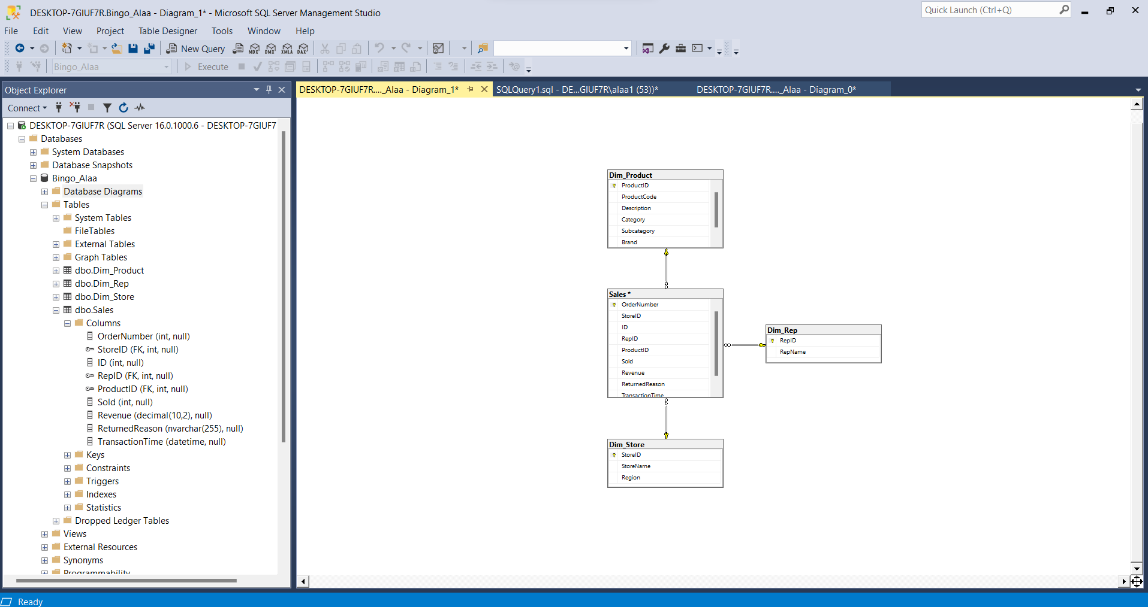

Slide 7
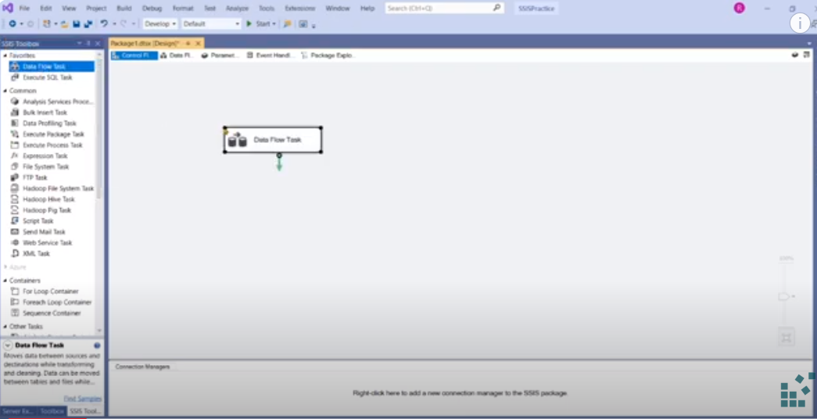
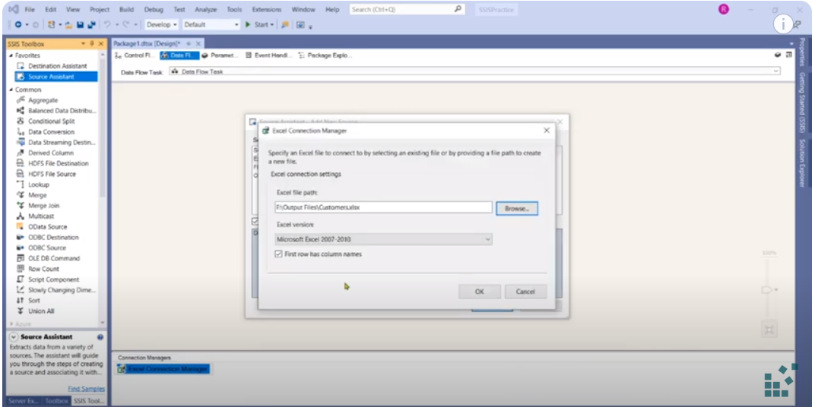
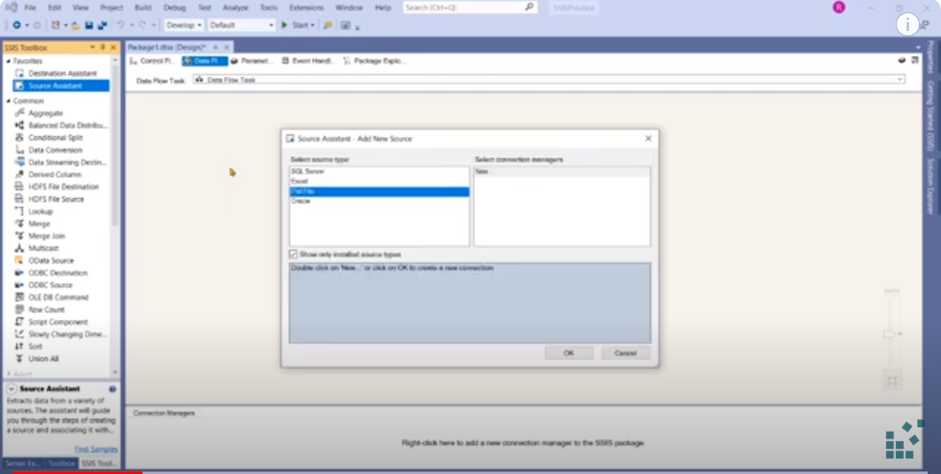
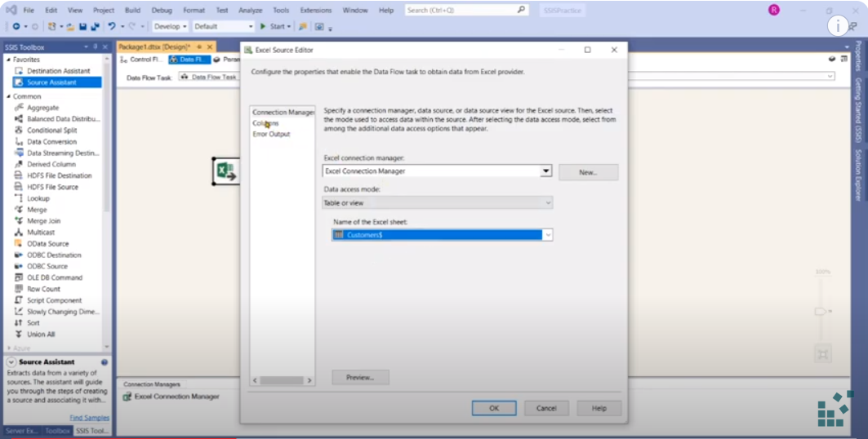

Slide 8
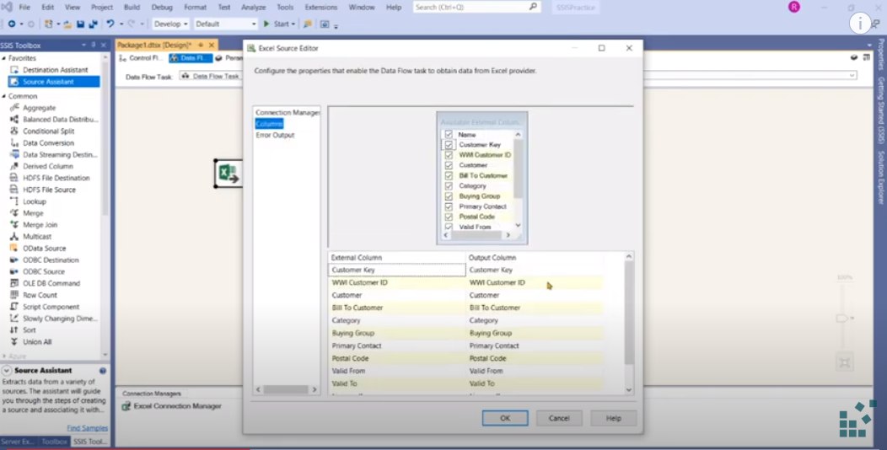
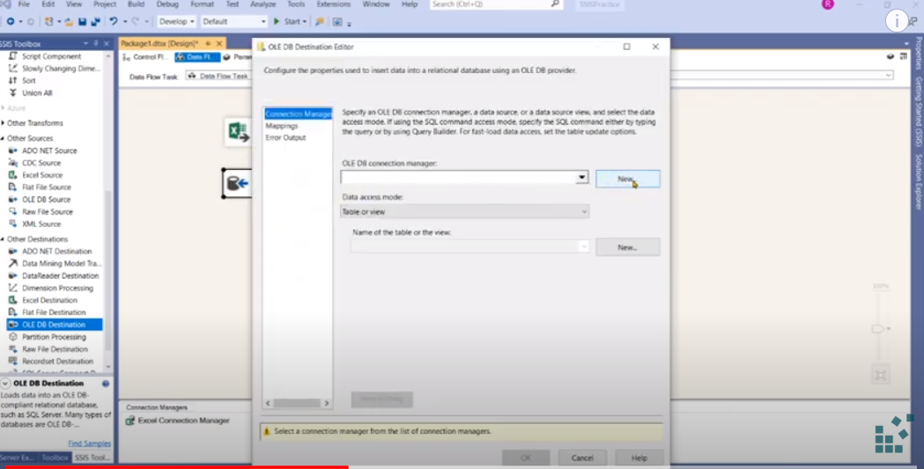
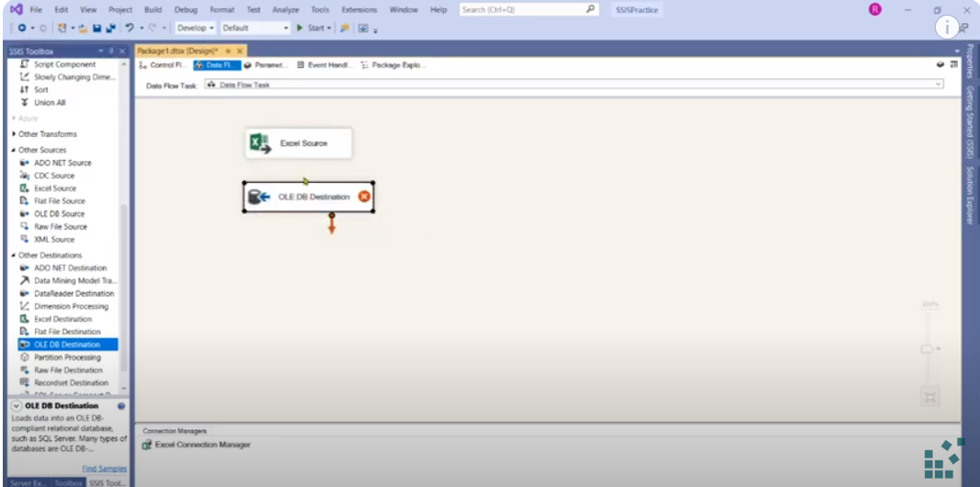
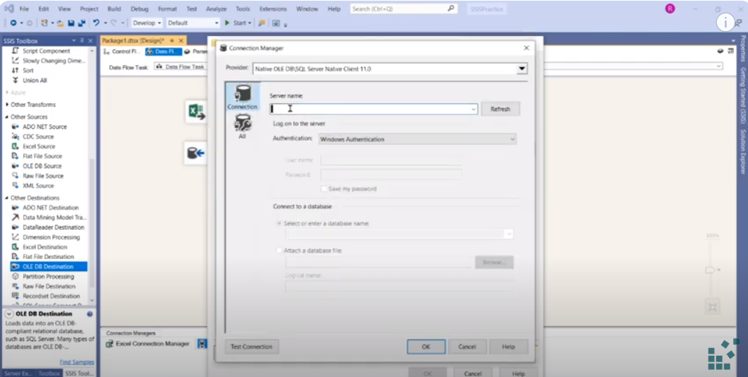

Slide 9
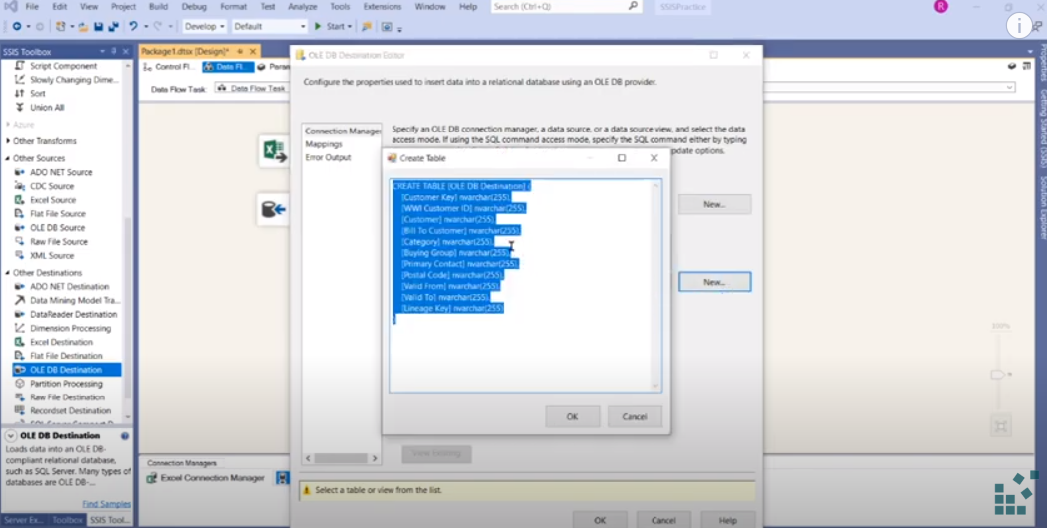
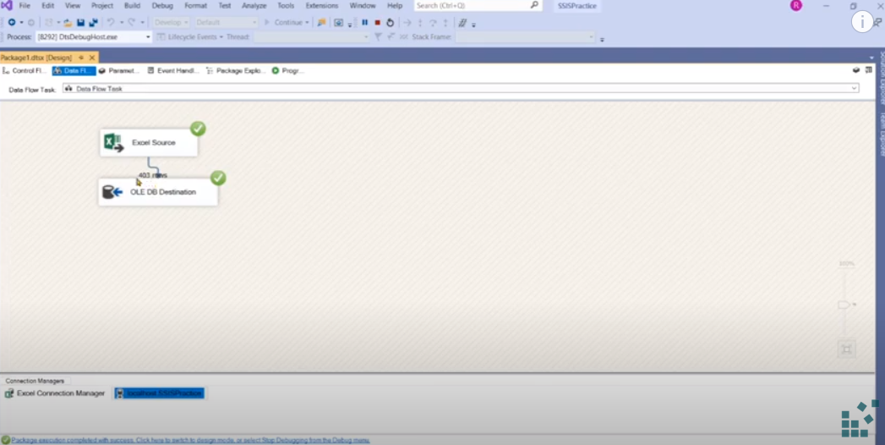
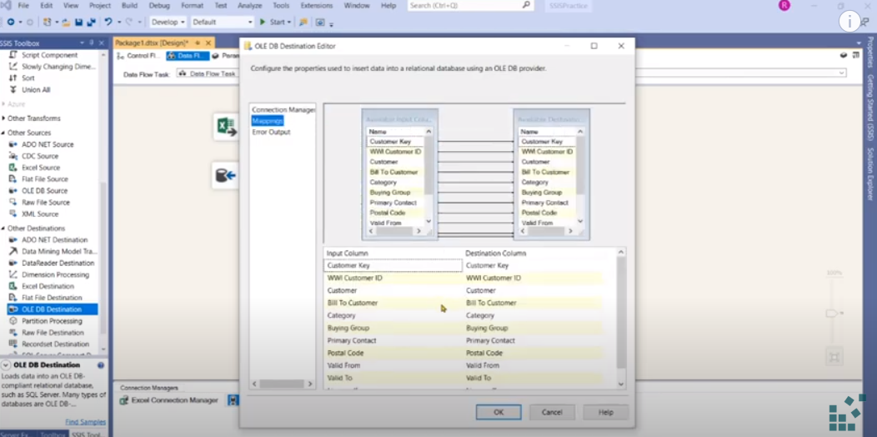
Refrence:
https://www.youtube.com/watch?v=PnAtiVUDRrA

Slide 10
3. Use Power BI to Solve the Challenges:
Connect to the DWH from Power BI and do descriptive analysis dashboard, and don’t forget to give attention to the dashboard design.

Slide 11
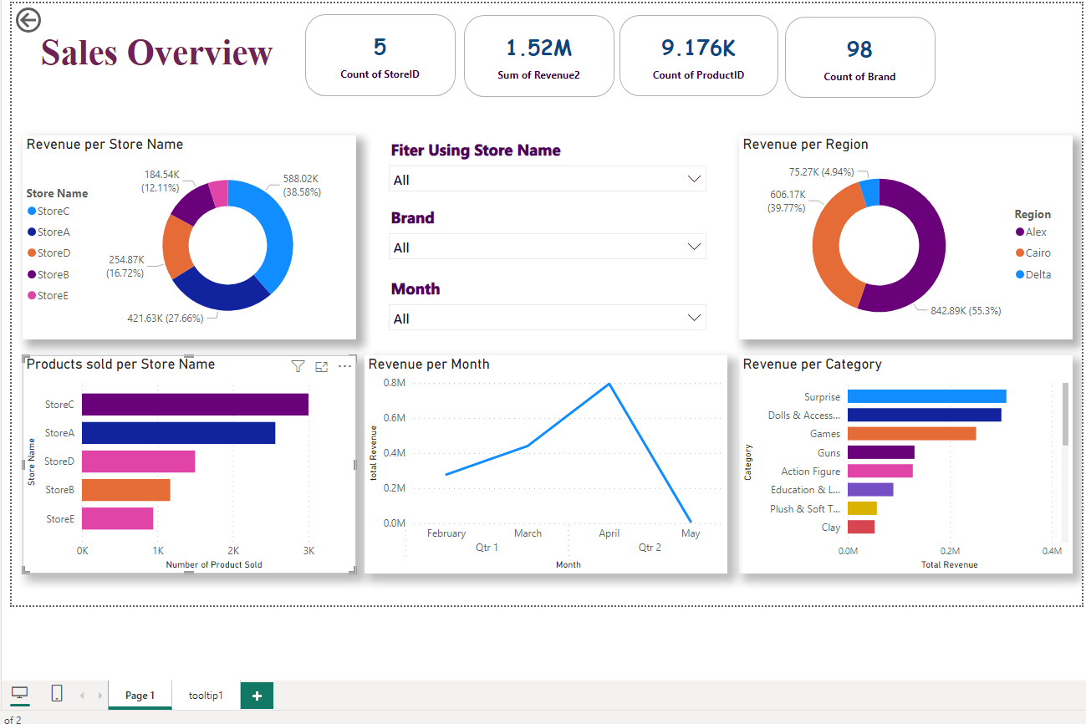

Slide 12
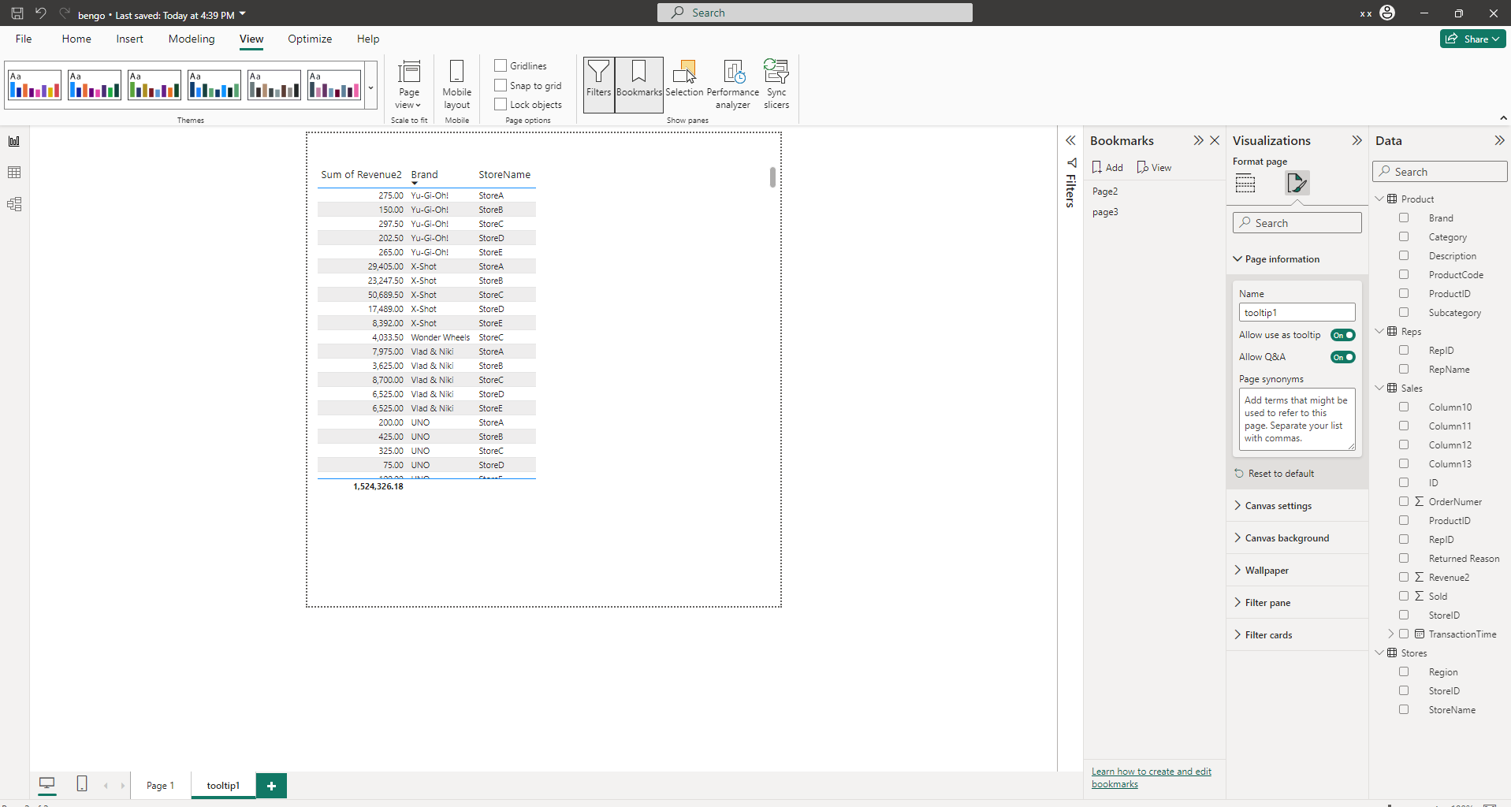

Slide 13
